Slide 1
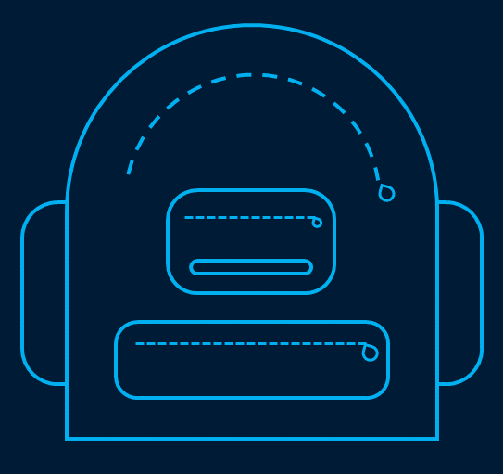
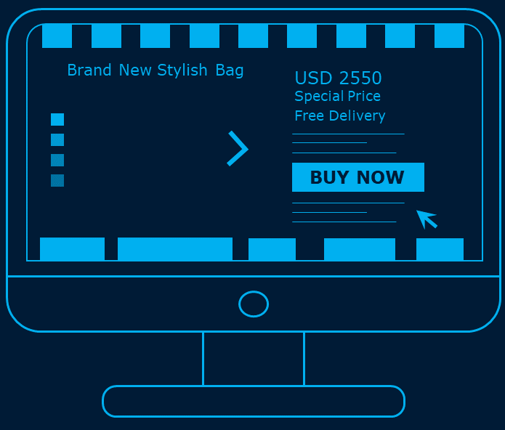


Brand New Mobile Phone
Brand New Desktop
Brand New Stylish Bag
Brand New Gaming Controller
USD 750
USD 7550
USD 2550
USD 1550
Special Price
Free Delivery
BUY NOW

